Slide 1
HOW TO WRITE ROLL NUMBER IN ANSWER BOOK
Roll Number of both Classes-X and XII will either start from ‘1’ or from ‘2’.
Digit ‘1’ or ‘2’ represent a special information
Answer Book is having the space for writing 7 digits
However, in 2020, Roll Number is of 8 digits
Then how to write the Roll Number in Answer Book
Write 1 or 2 before the box
Darken the place below 1 or 2 in 1st or 2nd line

Slide 2
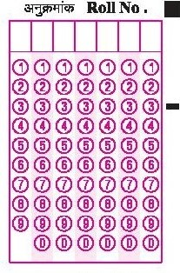
CORRECT METHOD OF WRITING R.NO.
WHEN ROLL NO. IS STARTING FROM 1
Example-R.No.- 11133323
1 | 1 | 3 | 3 | 3 | 2 | 3
1

Slide 3
CORRECT METHOD OF WRITING R.NO.
WHEN ROLL NO. IS STARTING FROM 2
R.No.- 26645242
6 | 6 | 4 | 5 | 2 | 4 | 2
2

Slide 4
WRONG METHOD OF WRITING R.NO.
R.No.- 11133323
1 | 1 | 1 | 3 | 3 | 3 | 2
3

Slide 5
WRONG METHOD OF WRITING R.NO.
R.No.- 11133323
1 | 1 | 1 | 3 | 3 | 3 | 2
3

Slide 6
WRONG METHOD OF WRITING R.NO.
R.No.- 11133323
1 | 1 | 1 | 3 | 3 | 3 | 2

Slide 7
WRONG METHOD OF WRITING R.NO.
R.No.- 26645242
2 | 6 | 6 | 4 | 5 | 2 | 4
2

Slide 8
WRONG METHOD OF WRITING R.NO.
R.No.- 26645242
2 | 6 | 6 | 4 | 5 | 2 | 4
2

Slide 9
WRONG METHOD OF WRITING R.NO.
R.No.- 26645242
2 | 6 | 6 | 4 | 5 | 2 | 4

